Slide 1


×
The Analysis and Prediction
of Propensity to Pay
SmithMachineLearner
November 2020
Notes:
Dear judges, we are team Smith Machine Learner, my name is ….. today we are going to share our Analysis and Prediction of Propensity to Pay based on Genpact invoice data set.

Slide 2

OUTLINE
Problem Statement
Feature Engineering
Data Cleaning
Modeling
Exploring the Issues
Suggestions
Notes:
We have six parts, Problem Statement, Data Cleaning, Exploring the Issues, Feature Engineering, Modeling, and Suggestions. Next, I will let …. take over.

Slide 3
Problem Statement

Slide 4
Problem Statement
We aim to analyze and predict customers’ propensity to pay , improving the strategies of payment collection and contributing to companies’ financial health.
Notes:
As Cash Flow and Working Capital become more and more vital for companies’ financial health, we expect B2B collections operations to segment customers and consider invoice features so that we can predict whether an invoice will be overdue and how long it will be overdue. So our goal is to analyze and predict customers’ propensity to pay based on invoice dataset provided by Genpact.

Slide 5

Problem Statement
What invoice features are related to overdue?
Customer: Name, Age of Customer, Zip Code, Region
Payment: Amount, Payment Term, Start Date, Due date
Notes:
As a company executives aiming to improve collections operation, they would like to know what invoice features are related to payment overdue? Based on the dataset, we could focus on features relate to Customers and Payments.

Slide 6
Data Cleaning

Slide 7
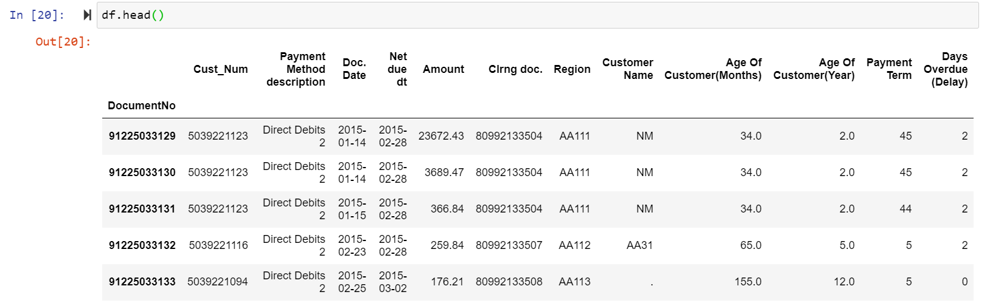
Data Cleaning
×
Step 1:
Drop duplicates
Set “DocumentNo” as the index, leading to finding 2 duplicated records having possibly wrong data
Step 2:
Convert data type
“Amount”: str. to float
“Doc. Date” & “Net due dt.”: str. to datetime
Step 3:
Drop columns
“Customer Group”: All are “Wholesaler”
“Pstng Date”: Identical to “Doc. Date”
“Clearing Date”: Duplicated information with random numbers
“City”: Too many categories
“ZIPCODE”: Too many categories
Notes:
Before we start analyzing data, we cleaned up the data set. We first drop duplicates Invoices. Then we Convert data type, changing Amount column from string to float for future aggregation, transforming columns including dates to datetime datatype for feature engineering, and dropping unrelated columns. Since Customer Group column only one value wholesaler, we delete it. Posing date column is the same as Doc. Date, we delete posting Date. Clearing Date column has random numbers and can be calculated by other columns, thus we drop it. For the three location related columns, City, Zip Code, and region, we only use region since City and Zip codes have about 60 unique values which is highly related customer number.

Slide 8
Exploring the Issues
Notes:
After cleaning the data set, we try to break down the core problem into several small issues by exploratory data analysis.

Slide 9
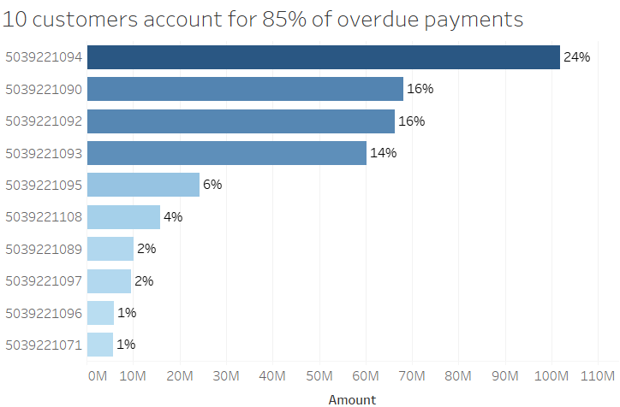
Exploratory Data Analysis (EDA)
×
Who
contributes to overdue?
Notes:
First, we would like to see who contributes to the major overdue payments amounts? We can see 10 customers account for 85% of overdue payments. This graph makes us curious about the common features these overdue customers share.

Slide 10
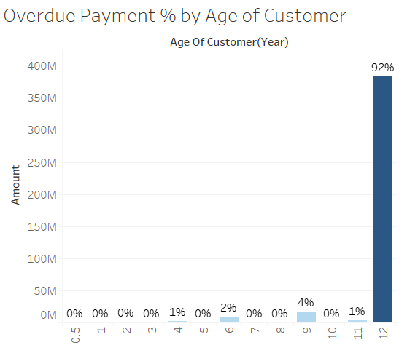
Exploratory Data Analysis (EDA)
×
Who is more likely to overdue?
Customers of 6+ years contributes to most amounts of overdue
Notes:
The first feature we identify is customer age. Customers of age over 6 years accounts for 99% payment overdue. They have higher propensity to pay overdue. And combined with the former graph, we could know the major overdue Payment are caused by old customers.

Slide 11
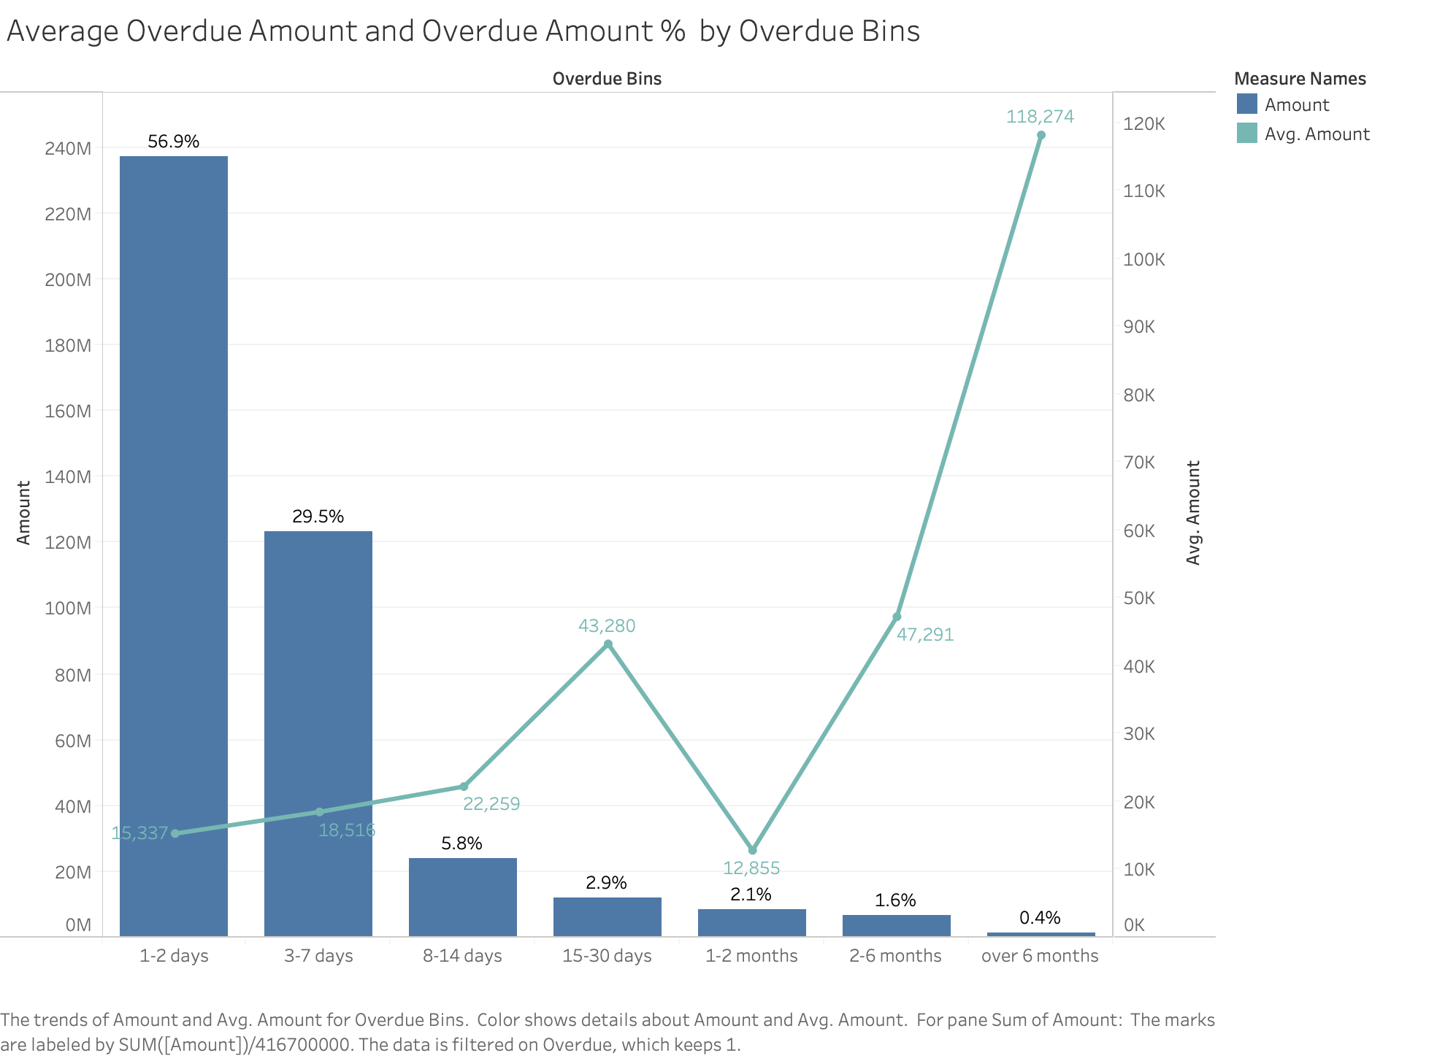
Exploratory Data Analysis (EDA)
×
How the amount varies in each bin?
Most amount of overdue are within a 1-2 days period, yet the average in this range is rather low
The average amount of overdue in “over 6 months” is high because there is only a small amount of data
Notes:
Next we want to see the relationship between overdue time and amount. We can see major overdue amount accumulate at 1-2 days delay and

Slide 12
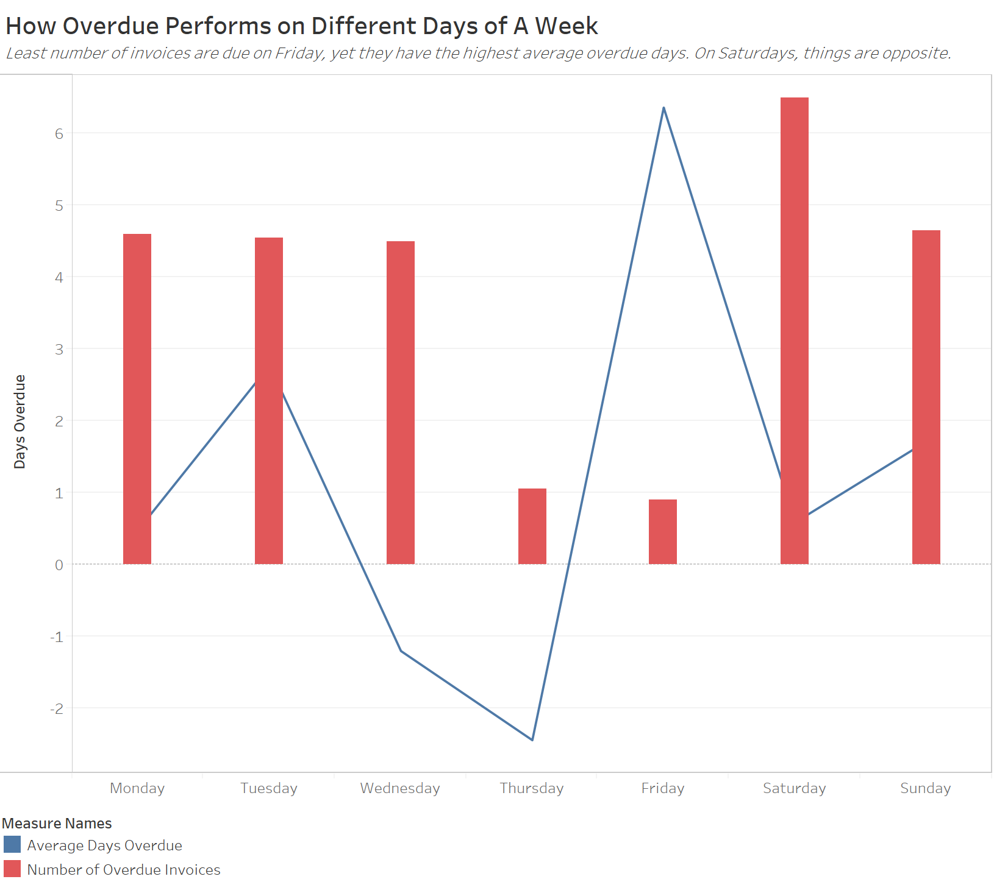
Exploratory Data Analysis (EDA)
×
When overdue happens?
Once a Friday-due-invoice overdues, it will be at least 3 days
Invoices due on Saturday may choose to pay in advance, finishing the transaction during weekdays

Slide 13
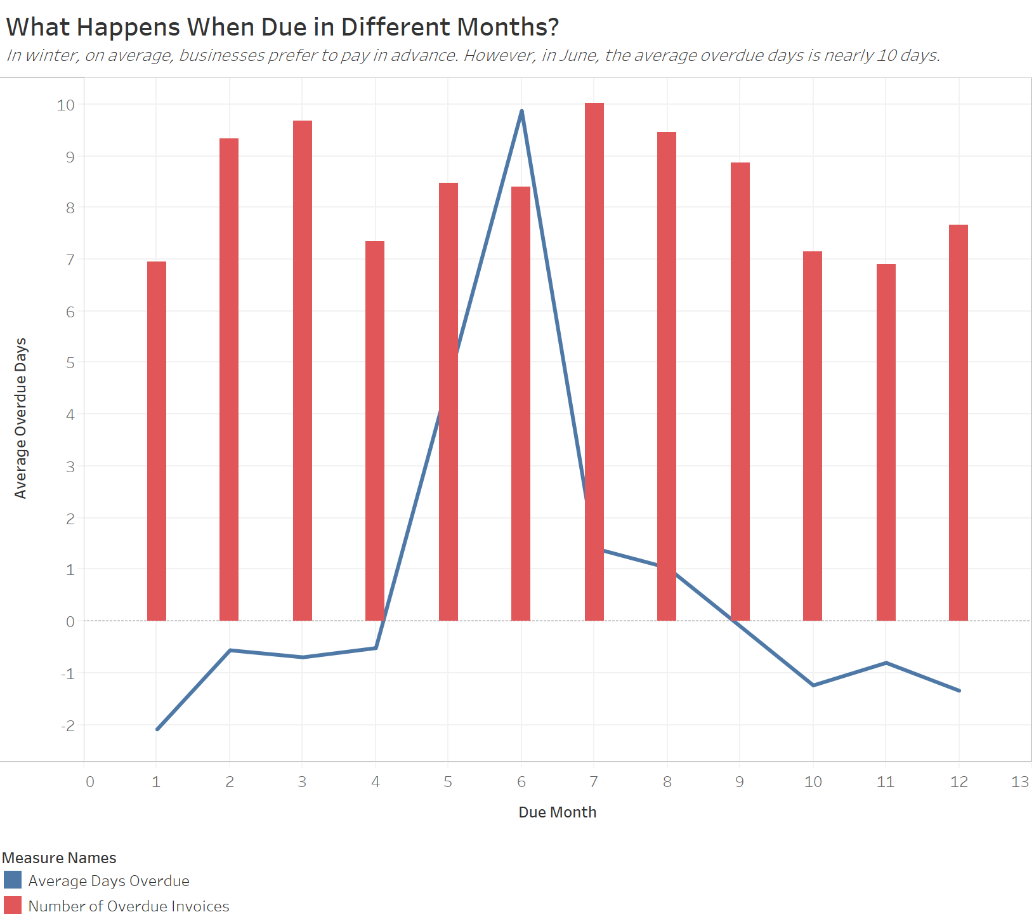
Exploratory Data Analysis (EDA)
×
When overdue happens?
The wholesale industry tends to be influenced by seasonality
Expect a 10-day overdue for invoices due in June

Slide 14
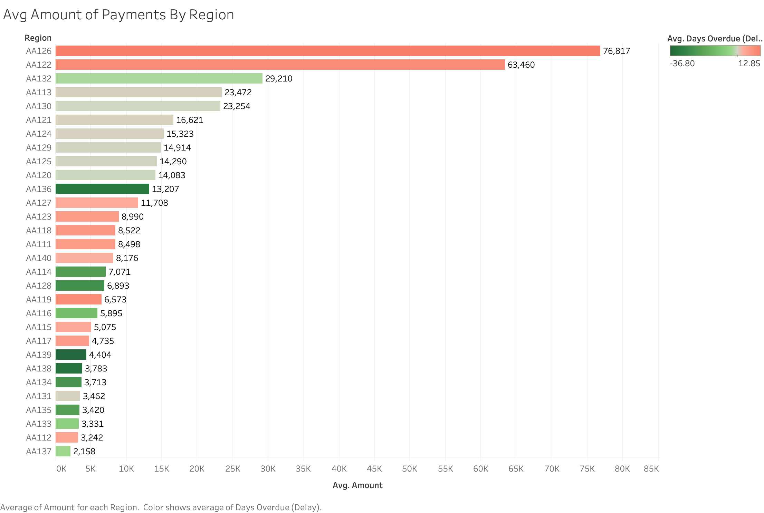
Exploratory Data Analysis (EDA)
×
Where are the regions that has the highest propensity to pay overdue?
AA132 is the best region where has a high payment amount yet low chances of overdue

Slide 15
Feature Engineering

Slide 16
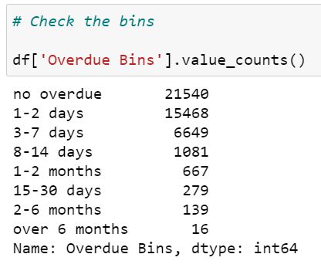

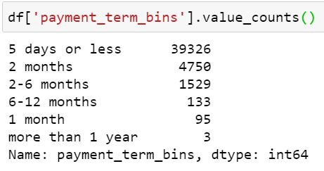
Feature Engineering
×
Binning:
Days Overdue (Delay)
New Variables:
Month, Year and Day of Week of “Net due dt” and “Doc. Date”
if_due_weekend (1 if the invoice is due on a weekend, 0 otherwise)
Amount
Key Region (1 if the region is top 6 populated with invoices, 0 otherwise)
Customer_Total_Delay
Payment Term
if_due_near (1 if a customer have other invoices due within 3 days, 0 otherwise)
Notes:
Feature Selection by Decision Tree
# Since Customer_Total_Delay & Payment Term are highly correlated, and Payment Term is more important, so remove Customer_Total_Delay
# Since the Zipcode, Region, and City essentially indicate a very similar object, so I only keep the zipcode
# Payment Term & Customer_Total_Delay is strongly negative correlated

Slide 17
Modeling

Slide 18
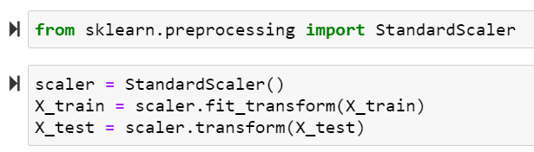
Modeling
×
How we made the model?
3. Converting to Dummies
Converting all categorical variables to dummy variables, including bins
Features Used:
2. Models Tried:
4. Train-Test Split
Amount
Age Of Customer(Months)
Payment Term
doc month
doc year
doc dow
due month
due year
due dow
Adj Close
Payment Method description
Region
Random Forest
XGBoost
KNN
Reserved 30% of the data as test data
5. Scaling (Without Data Leakage):
6. Grid Search and CV
Tuning hyperparameters
5-folds Cross Validation

Slide 19
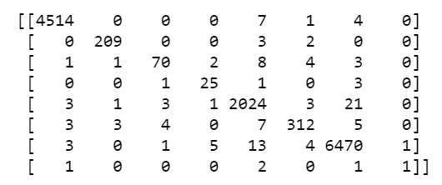
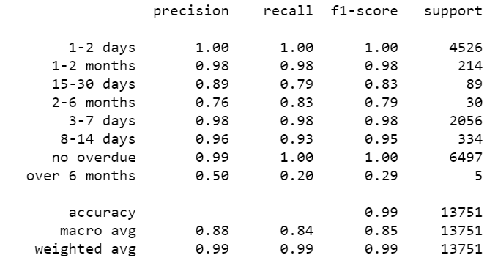

Modeling
×
The Winner Model!
Confusion Matrix:
XGBoost:
“max_depth” = 18
“n_estimators” = 25
Classification Report:
ROC_AUC_SCORE:
NO DATA LEAKAGE!

Slide 20
Suggestions

Slide 21
Suggestions
×
Care for the large, loyal clients
Large and loyal clients frequently have overdue of large amounts.
Pay-back encouragement/prizing plan, in order to maintain a healthy business relationship
Pay attention to seasonality and day-of-week preferences
Expect 1-2 days overdue, and don’t let it disturb the financial health of a company
Expand business in “good” regions with large demands and low chances of overdue
Use the model!

